Slide 1
2022
Group 9

Slide 2
Contents
01
Introduction of Dataset
02
Introduction of ML Model
Results
Conclusion and Prospect
03
04

Slide 3
01
Introduction of Dataset

Slide 4
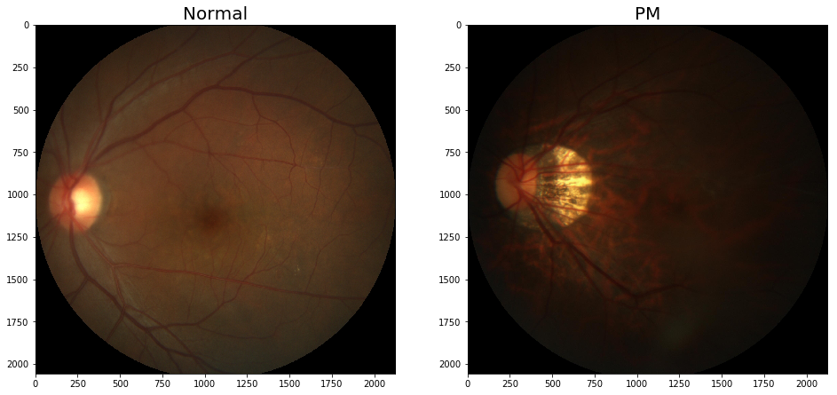
Clinical Background :
Myopia has become a global burden of public health. Among myopic patients, about 35% have high myopia. Myopia leads to elongation of axial length, potentially causing pathological changes in retina and choroid. With an increase in myopic refraction, high myopia will develop into pathologic myopia, which is characterized by formation of pathologic changes at: (1) posterior pole, including tessellated fundus, posterior staphyloma, retino-choroidal degeneration, etc; (2) optic disc, including parapapillary atrophy, tilting, etc; (3) myopic maculopathy, including lacquer crack, Fuchs spot, CNV, etc. Pathologic myopia causes irreversible visual impairment to patients. Therefore, it’s important to have early diagnosis and regular follow-up. Myopia has become a global burden of public health. Among myopic patients, about 35% have high myopia. Myopia leads to elongation of axial length, potentially causing pathological changes in retina and choroid. With an increase in myopic refraction, high myopia will develop into pathologic myopia, which is characterized by formation of pathologic changes at: (1) posterior pole, including tessellated fundus, posterior staphyloma, retino-choroidal degeneration, etc; (2) optic disc, including parapapillary atrophy, tilting, etc; (3) myopic maculopathy, including lacquer crack, Fuchs spot, CNV, etc. Pathologic myopia causes irreversible visual impairment to patients. Therefore, it’s important to have early diagnosis and regular follow-up.
400 pictures in training set and test set
iChallenge-PM

Slide 5
02
Introduction of ML Model

Slide 6
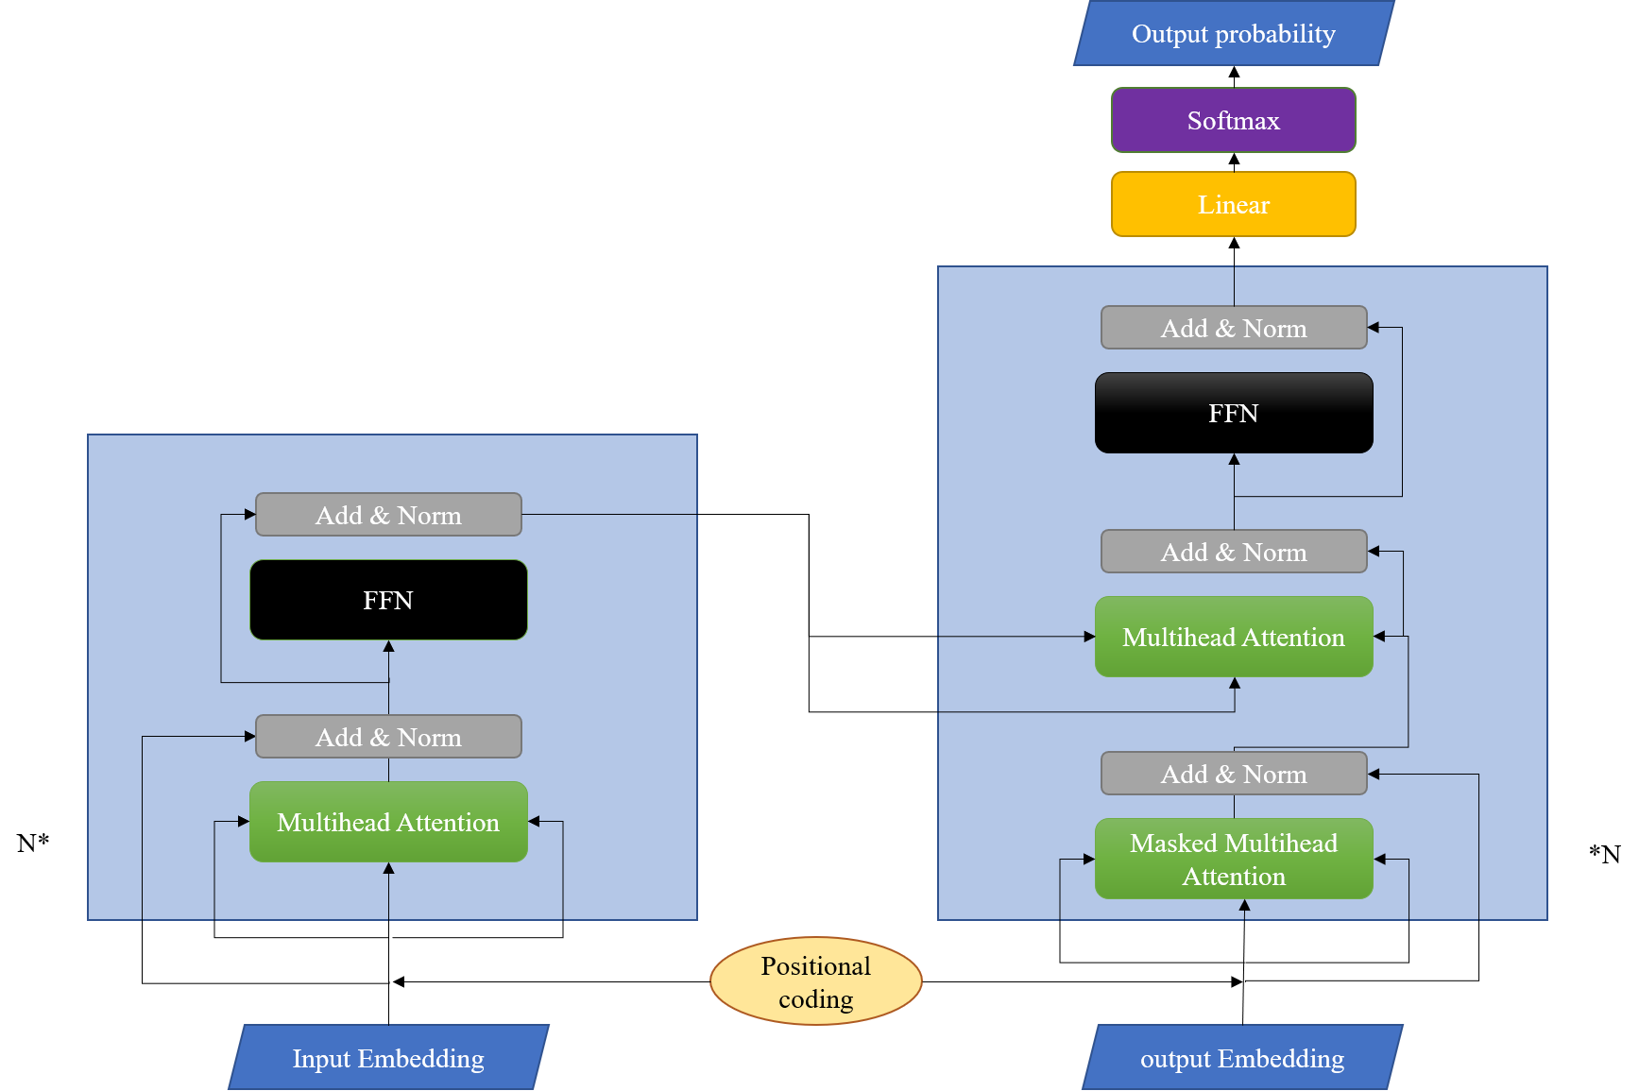
Development and Background of Transformer and Vision Transformer
Transformer
The Transformer model is a seq2seq model proposed by the Google Brain team in the paper Attention Is All You Need published at the end of 2017.
It was originally applied in the field of Natural Language Processing (NLP) and achieved great success
Transformer model

Slide 7
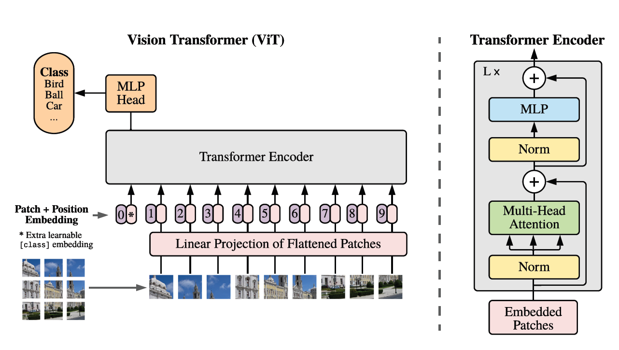
In 2020, the Transformer model was successfully applied to the field of image classification in computer vision in the paper "An image is worth 16*16 words", and the ViT model has officially entered people's field of vision.
Vision Transformer model

Slide 8


Slide 9
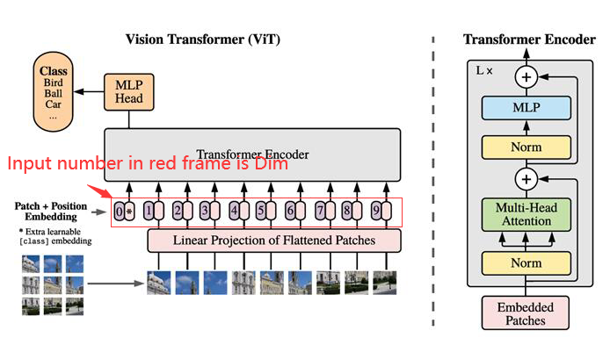
Activation Function
Learning rate
Dim
Number of head
Vision Transformer model

Slide 10
03
Results

Slide 11
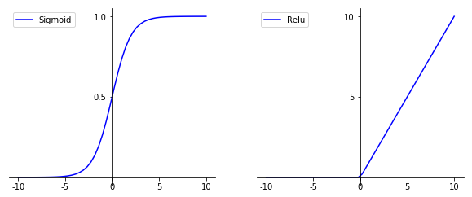
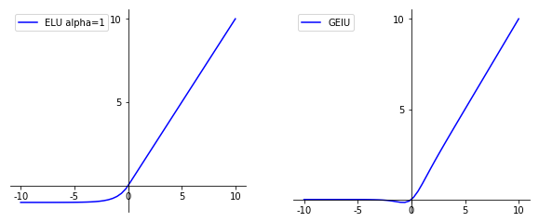
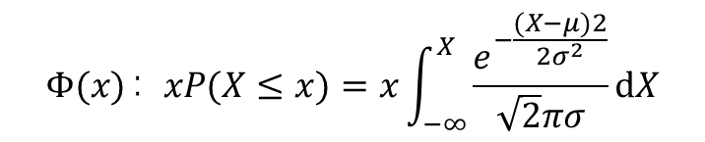
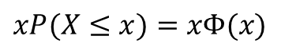
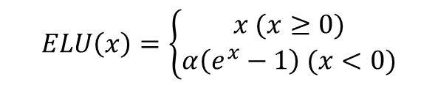
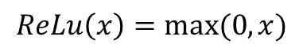
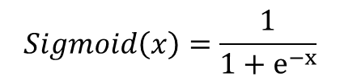
Activation Function
$$Sigmoid\left(x\right)=\frac{1}{1+e^{−x}}$$
$$ELU\left(x\right)=\left\{\begin{aligned}x (x≥0) \\ α\left(e^{x}−1\right) (x<0)\end{aligned}\right.$$
$$xP(X≤x)=xΦ(x)$$
$$ReLu\left(x\right)=max⁡(0,x)$$
$$Φ(x)：xP(X≤x)=x\int_{−∞​}^{X}{\frac{e^{−\frac{(X−μ)2}{2σ^{2}}}}{\sqrt{2}πσ}}​​dX$$

Slide 12
Activation Function

Slide 13
Learning rate

Slide 14
Dim
添加小标题
在这里添加你的详细小段落文本内容，与标题相关并符合整体语言风格，将你需要表达的意思表述清楚完整，保持美观大方。

Slide 15
Number of Head
添加小标题
在这里添加你的详细小段落文本内容，与标题相关并符合整体语言风格，将你需要表达的意思表述清楚完整，保持美观大方。
Heads | 2 | 4 | 8 | 16 | 32
Time（s） | 2553.26 | 6269.39 | 7445.98 | 9381.08 | 13432.54

Slide 16
04
Conclusion and Prospect

Slide 17
In this project, we use VIT model to classify picture of eyeball into normal eyeball and sick eyeball.
In this project, we use different parameter in VIT model, and gain different results. By this way, we learn some knowledge of vit model’s principle.
In this project, we only use one model to analyze the dataset. In the future, if we can use more model to analyze this dataset, we can gain more comprehensive results.

